Slide 1


Automated Ball Balancing System using PID Control.

Slide 2
Ayman Zafar 021 191 058
Jinedin Jidan 021 192 040
Team 05

Slide 3
CONTENT
01
02
03
04
Introduction
Objective
Purpose
About PID
05
06
07
08
Components
Diagram
Result & Usage
Conclusion

Slide 4
Introduction
This project aims to design and implement a PID control system to balance a ball on a tilting platform. The goal is to maintain the ball's position at the center of the platform by continuously adjusting the platform's tilt angle in response to the ball's position.
04

Slide 5
Objective
01
Stability
02
Precision Control
03
Real Time Feedback
04
Scalability
05

Slide 6

Purpose of Ball Balancing project
Education and Learning | Serve as an educational tool to help students and enthusiasts understand principles of control theory, feedback systems, and mechatronics.
Demonstration of Control Systems | Showcase the capabilities of control systems in maintaining stability and balance, demonstrating their relevance in industrial automation and robotics.
Problem-Solving | Address the challenge of developing a system that can dynamically balance a ball, requiring creative problem-solving and engineering solutions.
Practical Application | Explore the practical applications of control systems, such as those used in autonomous vehicles, industrial automation, or other fields where stability and precision control are crucial.
06

Slide 7
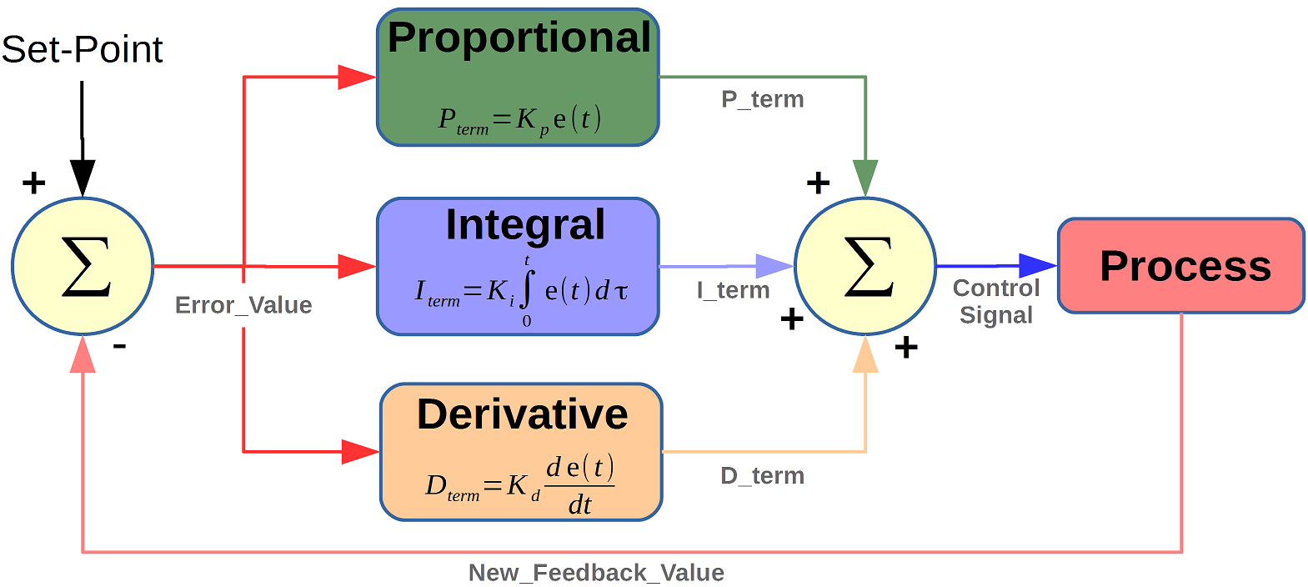

About PID
A PID controller is a widely used feedback control mechanism
Proportional (P) responds to the current error
Integral (I) accumulation of past error
Derivative (D) rate of change of the error
07

Slide 8
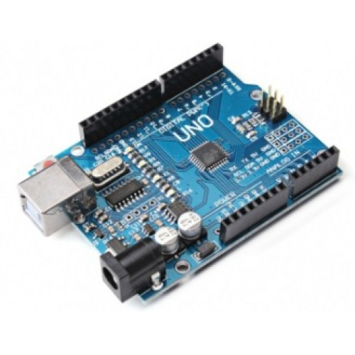
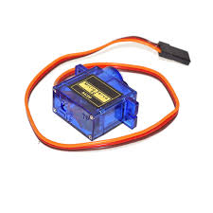
Components
Arduino UNO
Servo Motor
08

Slide 9
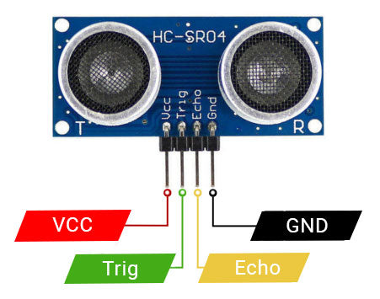
Components
Ultrasonic sensor
09

Slide 10
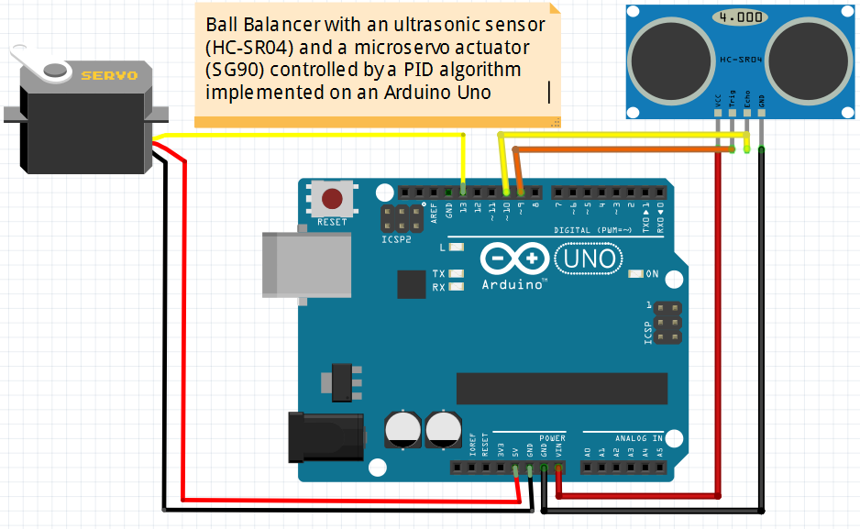
Connection Diagram
10

Slide 11
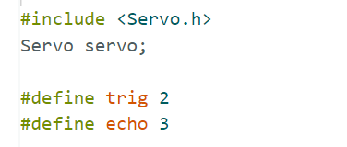

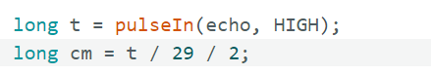
Code
1.Firstly, the servo motor library is included.
#include <Servo.h> Servo servo;
2.Secondly, the ultrasonic sensor pins are defined.
#define trig 2 #define echo 3
3.Thirdly, let’s includes the kp,ki and kd values.
#define kp 15
#define ki 0.02
#define kd 20
4 . Adjusting PID Controller
11

Slide 12
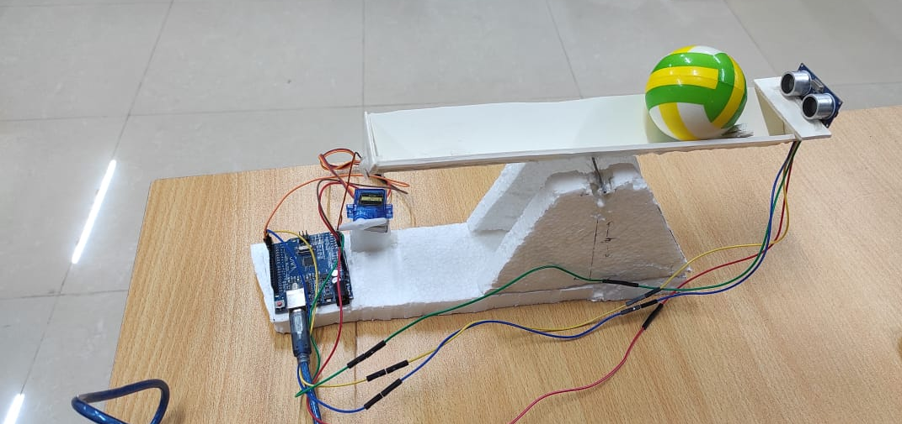
Hardware
12

Slide 13
Result
Stable and Balanced
Precision and Responsiveness
Minimized Oscillations and Overshoot
Adaptability to Disturbances
Consistency and Reliability
13

Slide 14
Real Life Usage
The real-life usage of a ball balancing project using a PID system is diverse and impactful across various fields. Here are some practical applications:
Industrial Automation
Educational Purposes:
Research and Development
Process Control
Robotics:
14

Slide 15
Conclusion
Smart technologies efficiency and sustainability.
Improved fish health management through real-time monitoring
Sustainable practice for fisheries and environment
Ongoing innovation offers future opportunities

Slide 16
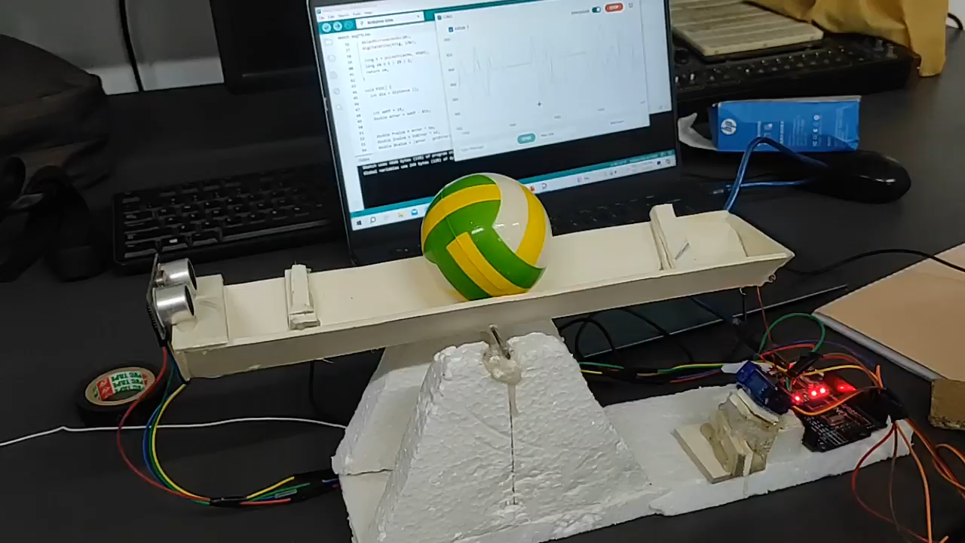
Experiment
`16

Slide 17
THANK YOU

